Slide 1
Lecture 16 Simulation Based Inference for Astrophysics and Cosmology
Lecturer: Dr Harry Bevins (htjb2)

Slide 2
Overview
What is Simulation Based Inference?
Approximate Bayesian Computation
Neural Posterior Estimation
Neural Ratio Estimation

Slide 3
What is Simulation Based Inference?

Slide 4
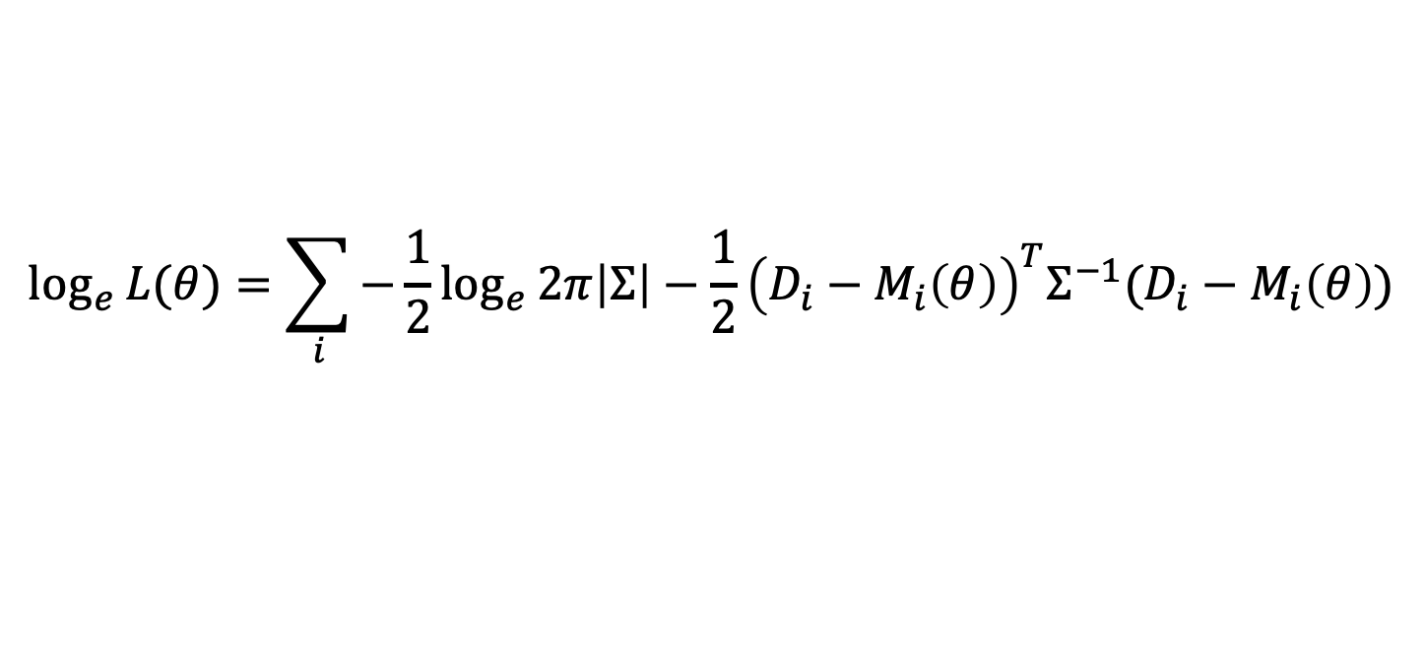
Why not emulate the likelihood?
$$\log_{e}{L(θ)}=\sum_{i}{−\frac{1}{2}\log_{e}{2π\left|Σ\right|−\frac{1}{2}{\left(D_{i}−M_{i}\left(θ\right)\right)}^{T}Σ^{−1}(D_{i}−M_{i}\left(θ\right))}}$$
In the last lecture I discussed how the likelihood defines the noise distribution we expect in our data
But often this is hard to know and approximations like the above Gaussian don’t really describe our data well
We looked at emulating the model describing our data but we can also think about emulating our likelihood function

Slide 5
Simulation Based Inference (SBI)
Sometimes referred to as Likelihood-free Inference (not a good name)
Or Implicit likelihood inference (a decent name)
The idea is to learn an approximation for the likelihood or indeed the posterior via simulations of the data
Simulations here includes the physics we are interested in, and contaminating signals, the noise and the impact of the instrument we are observing with

Slide 6
Simulation Based Inference (SBI)
Beneficial when we can not analytically write the likelihood, we do not know the noise distribution in our data or the analytic likelihood is too computationally expensive
For example, we might want to do field level inference on images from the SKA (analytically hard to define likelihood)
Or we might want to do quick follow up observations of Gravitational Wave observations (GW analytic likelihoods are very complete but to slow to trigger follow up observations)

Slide 7
Approximate Bayesian Computation

Slide 8
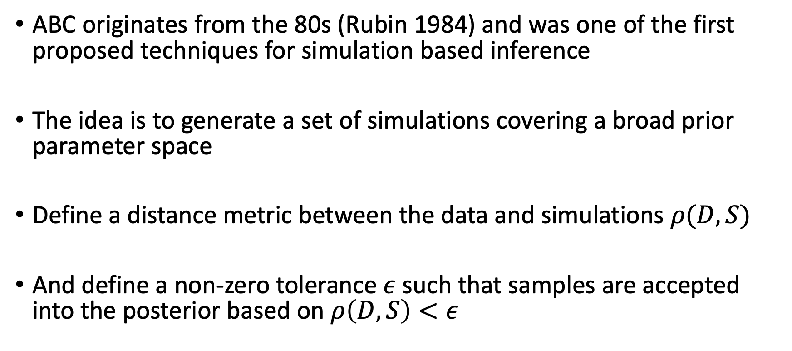
The idea
ABC originates from the 80s (Rubin 1984) and was one of the first proposed techniques for simulation based inference
The idea is to generate a set of simulations covering a broad prior parameter space
Define a distance metric between the data and simulations $ρ(D, S)$
And define a non-zero tolerance $ε$ such that samples are accepted into the posterior based on $ρ\left(D, S\right)<ε$

Slide 9
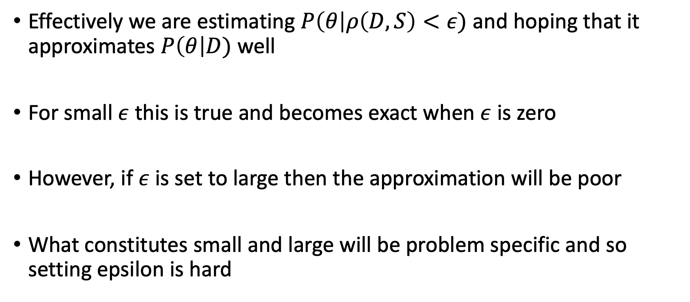
Approximating the posterior
Effectively we are estimating $P\left(θ\right|ρ\left(D, S\right)<ε)$ and hoping that it approximates $P\left(θ\right|D)$ well
For small $ε$ this is true and becomes exact when $ε$ is zero
However, if $ε$ is set to large then the approximation will be poor
What constitutes small and large will be problem specific and so setting epsilon is hard

Slide 10
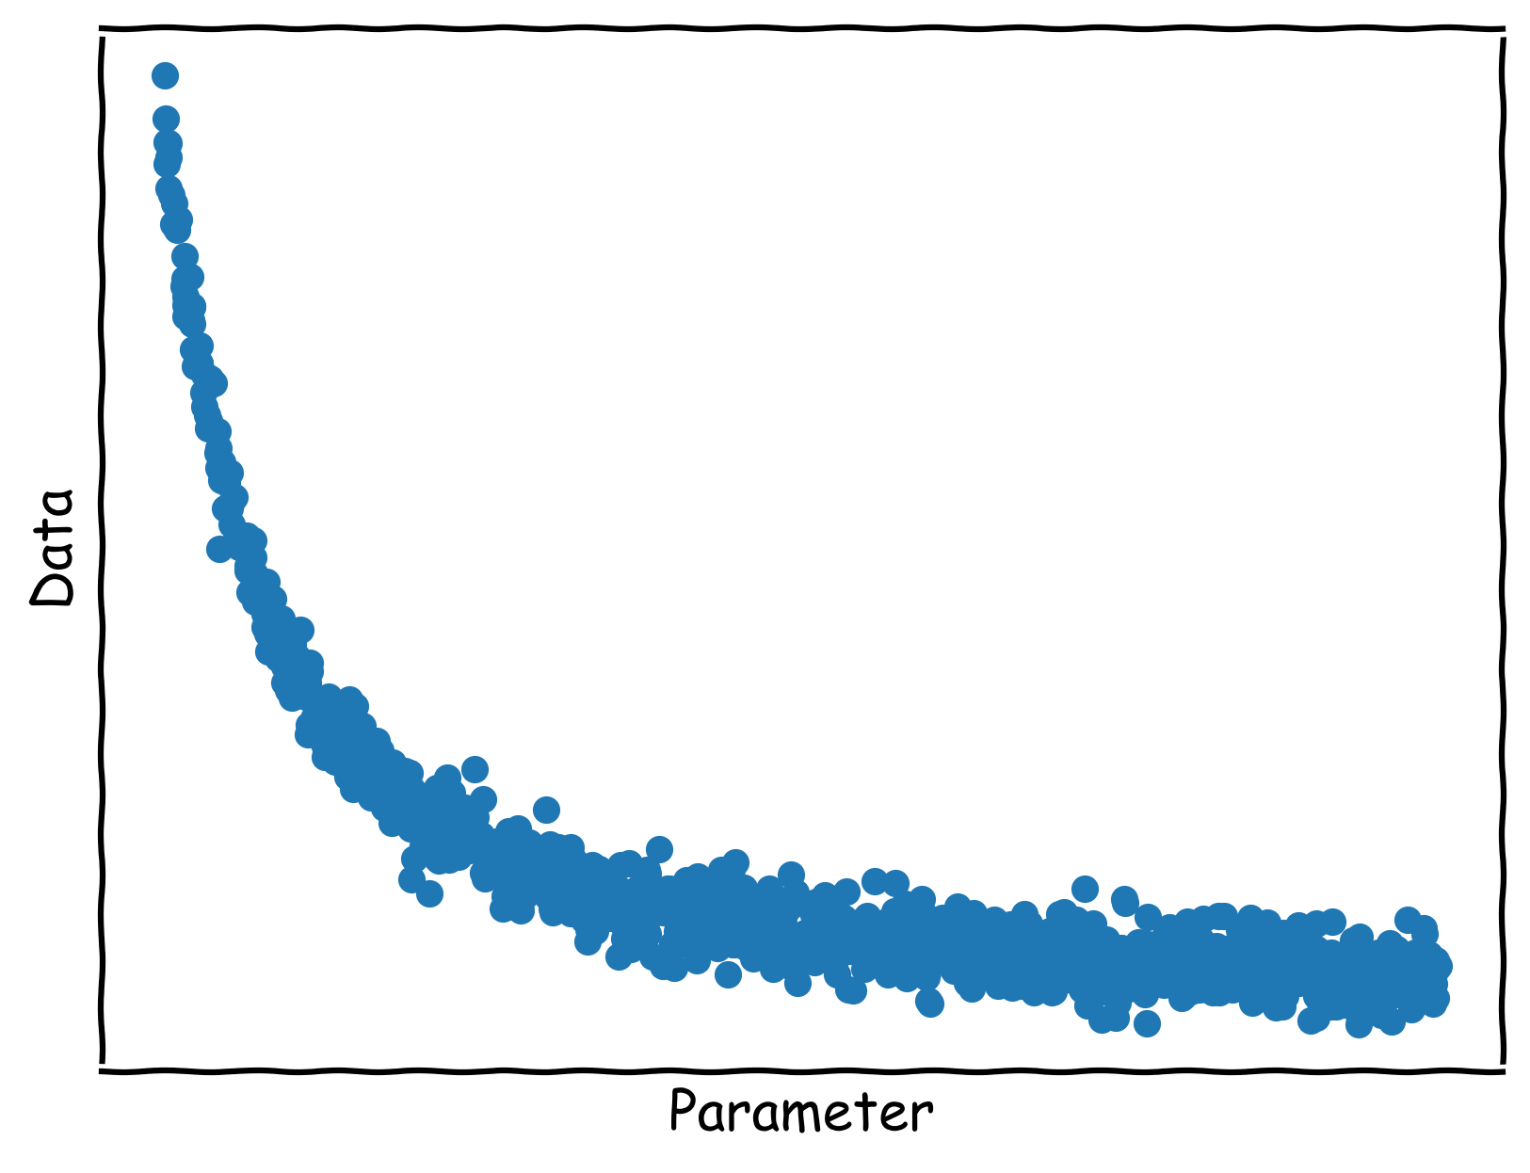
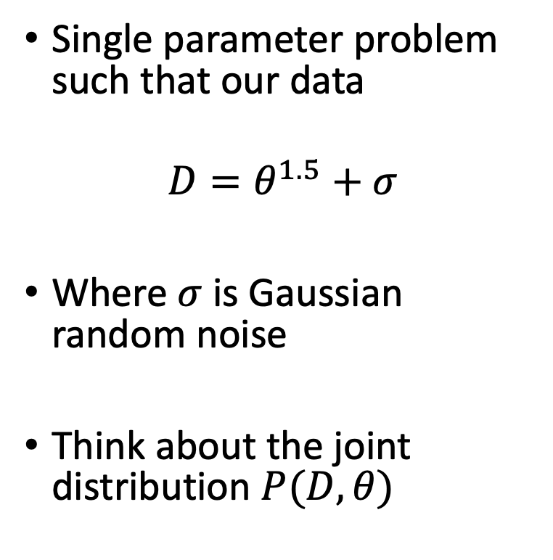
An Example
Single parameter problem such that our data
$$D=θ^{1.5}+σ$$
Where $σ$ is Gaussian random noise
Think about the joint distribution $P(D, θ)$

Slide 11
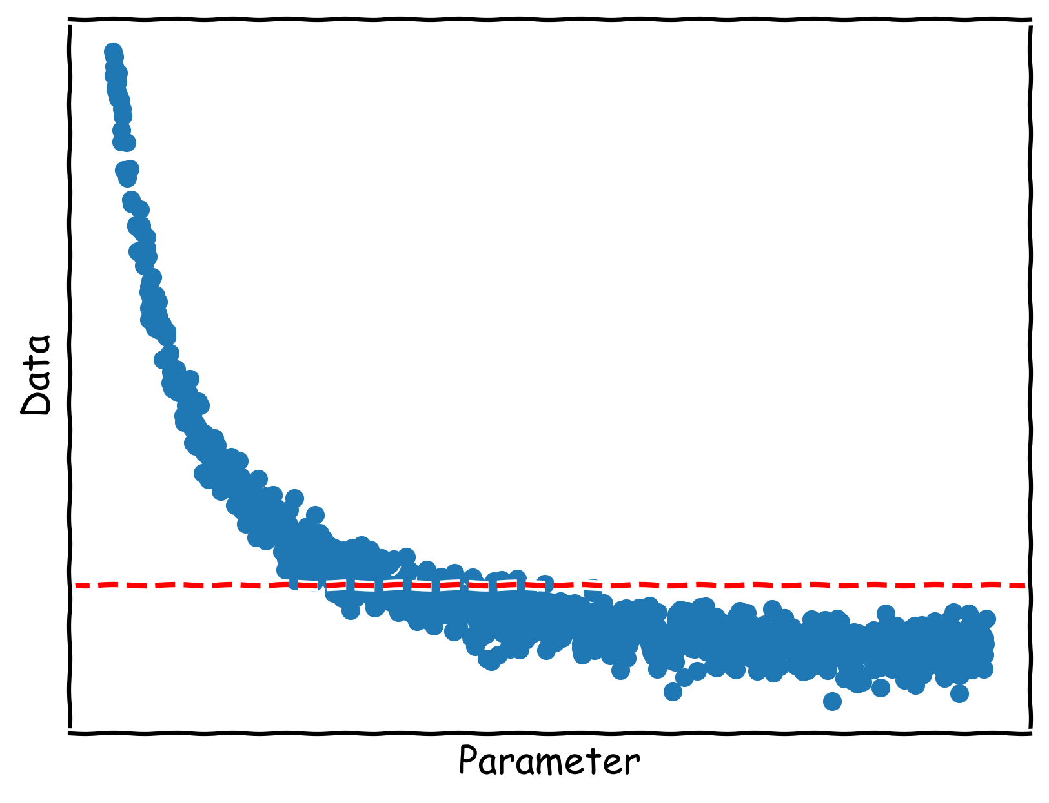
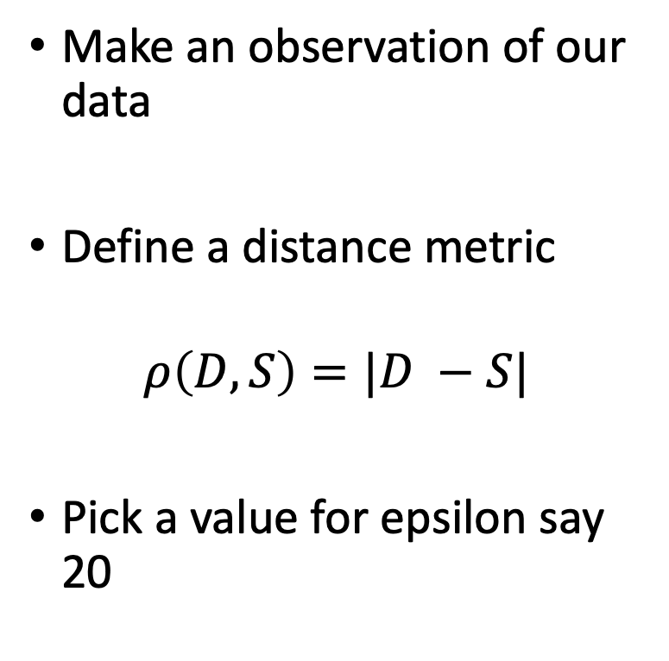
An Example
Make an observation of our data
Define a distance metric
$$ρ\left(D, S\right)=|D −S|$$
Pick a value for epsilon say 20

Slide 12
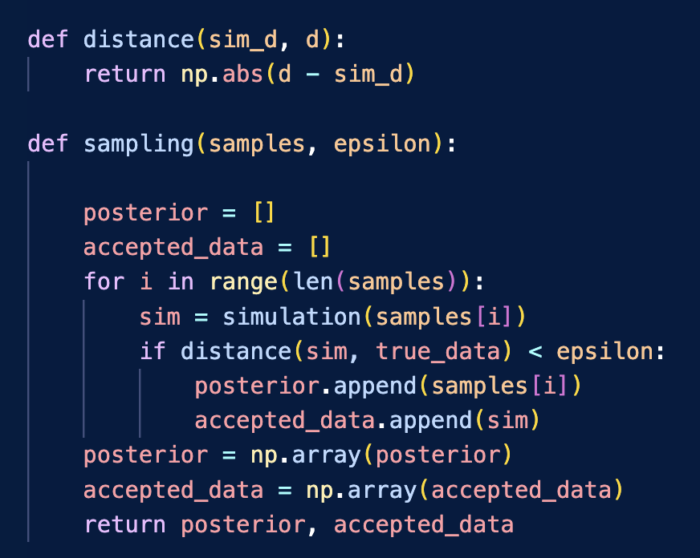
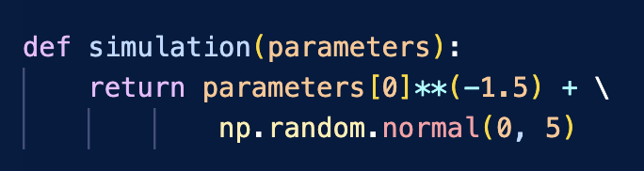

What does the algorithm look like?
Distance Metric
Prior Samples
Simulation code
$$ρ\left(D, S\right)<ε$$
Accepted samples and simulations

Slide 13
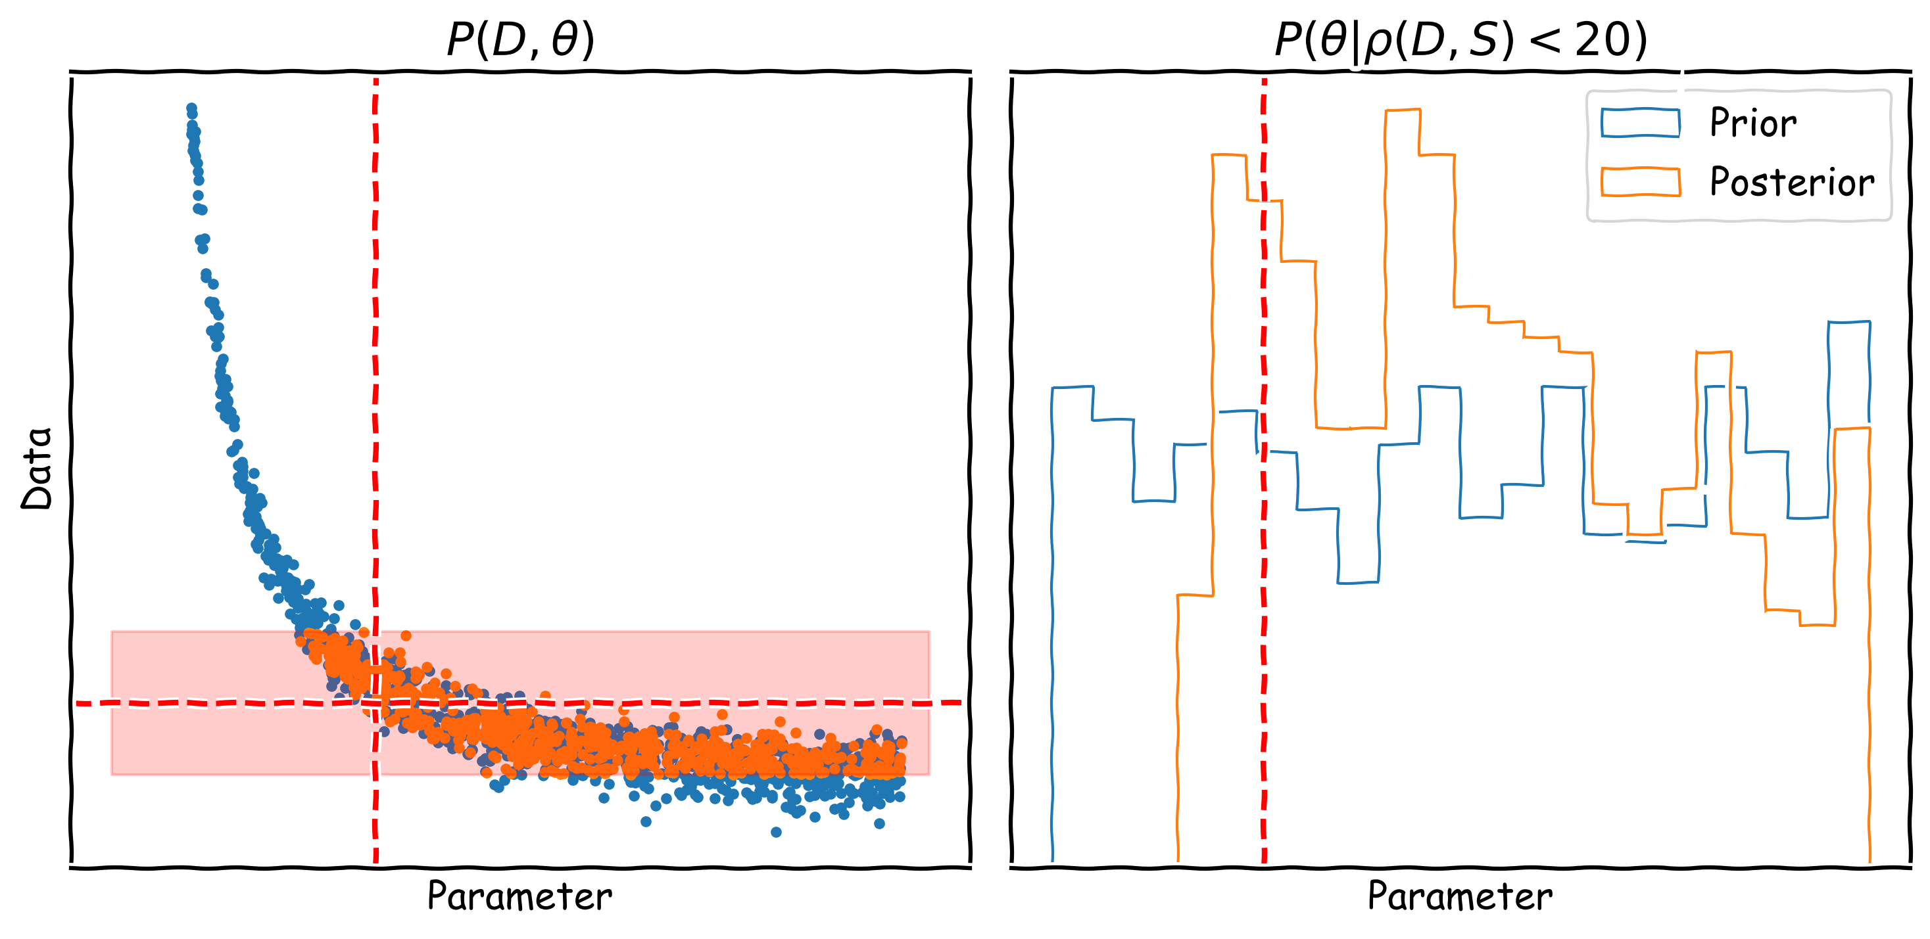
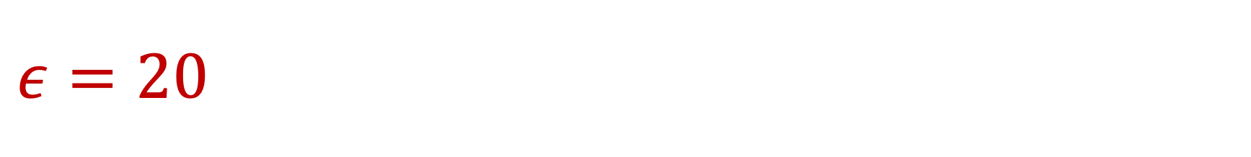
$$ε=20$$

Slide 14
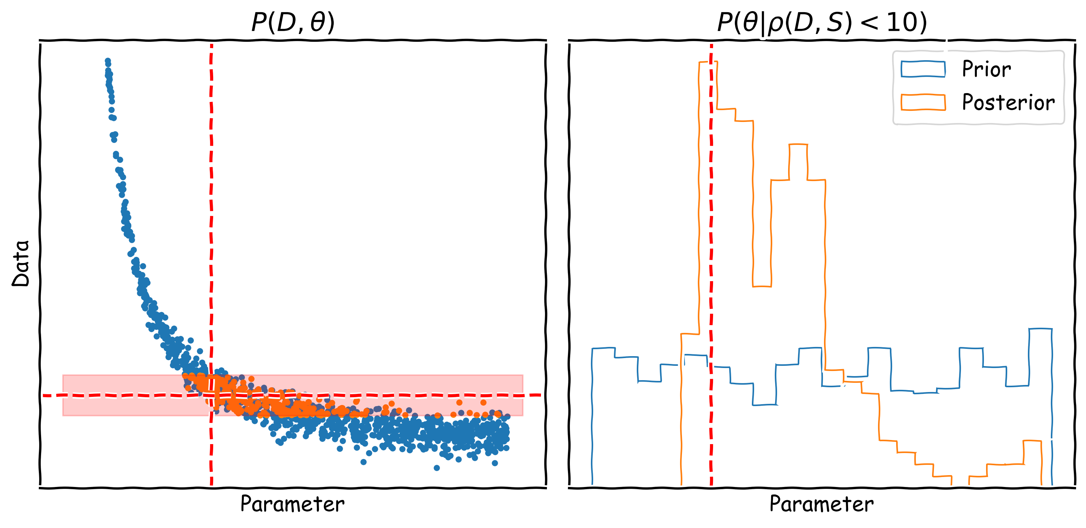
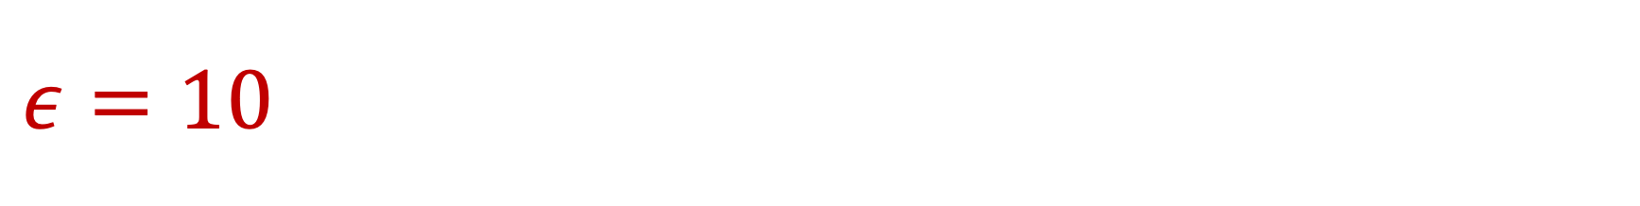
$$ε=10$$

Slide 15
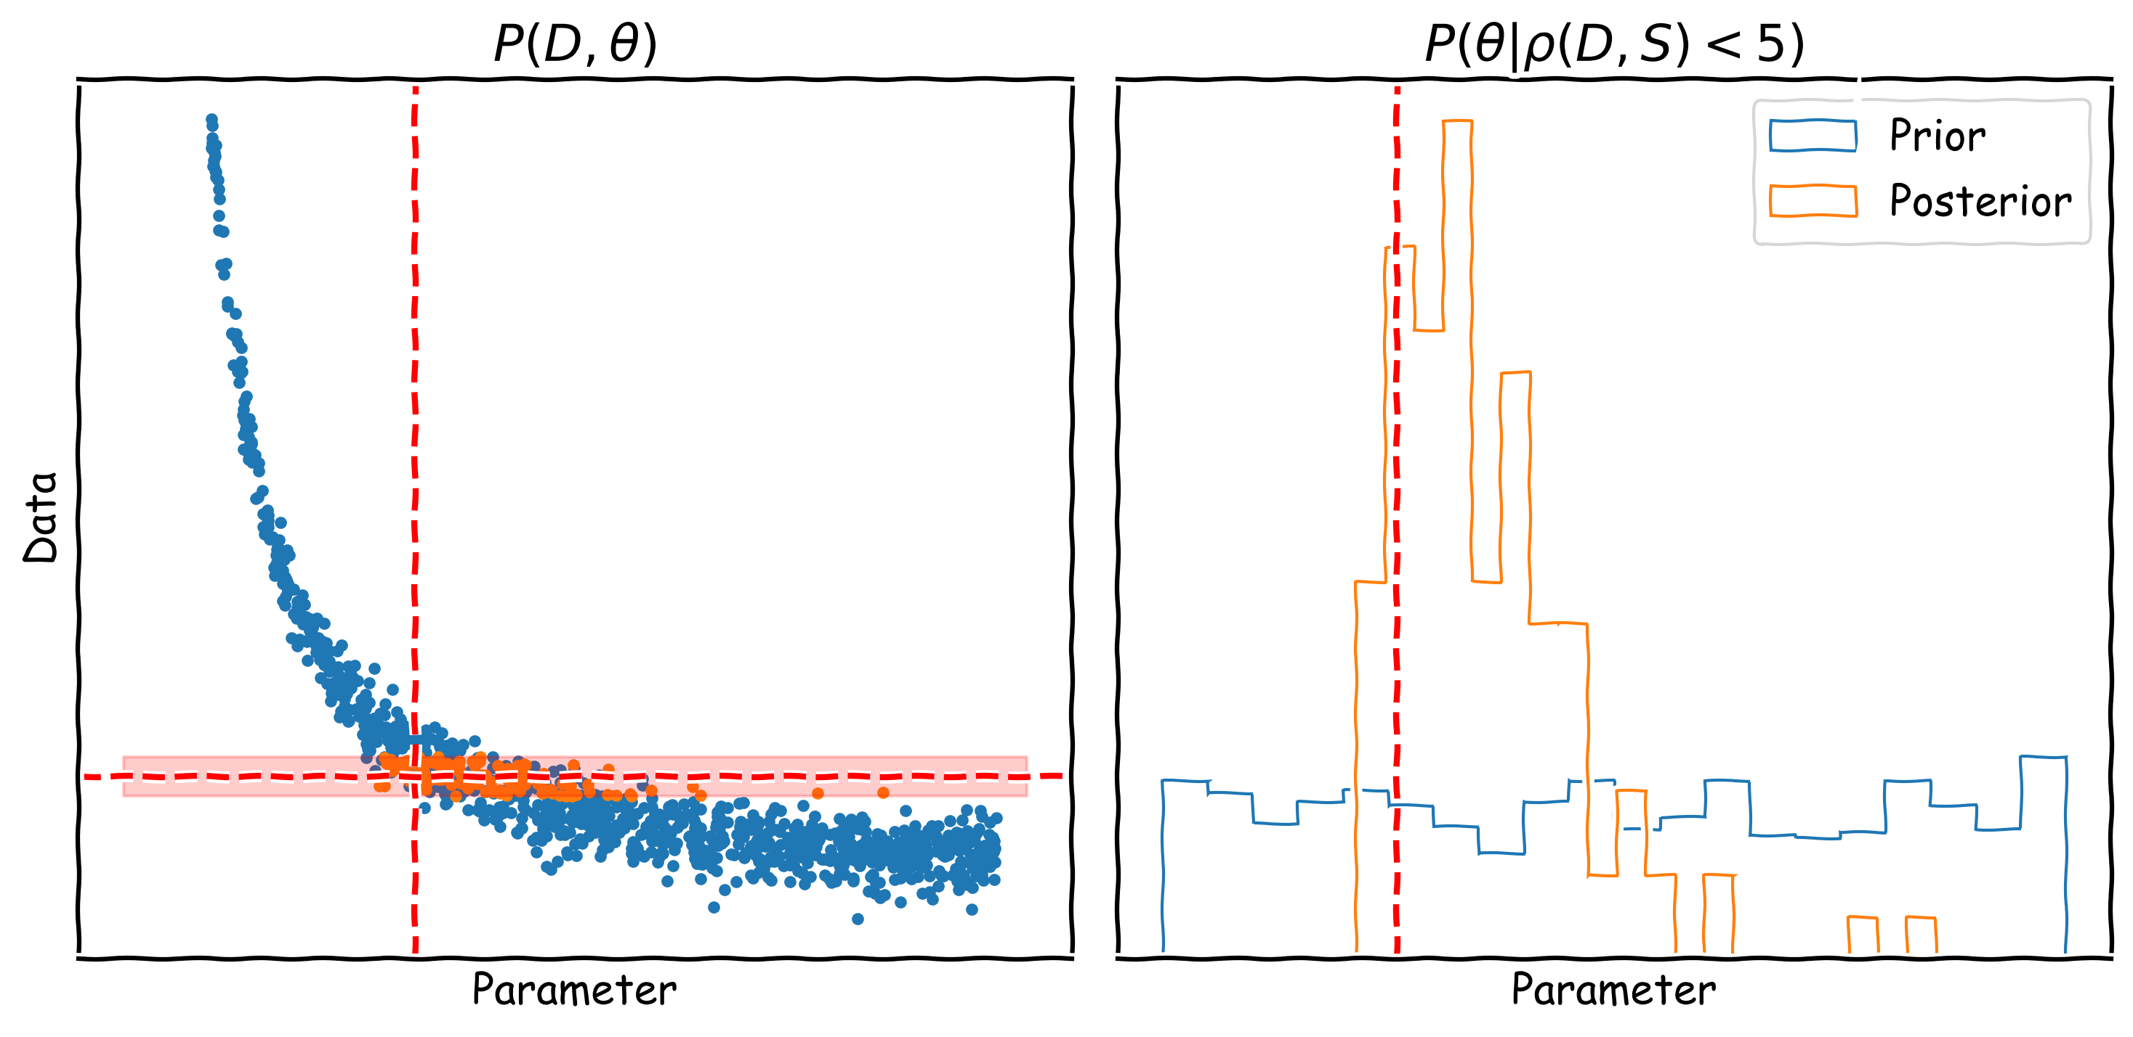
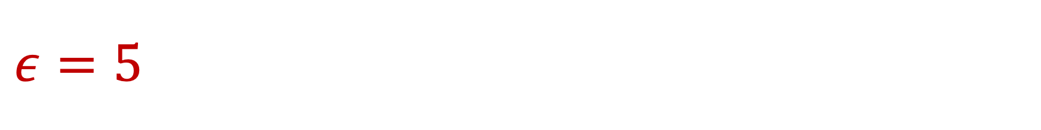
$$ε=5$$

Slide 16
No likelihood calls
We did not make a single call to any likelihood function here
But there is a cost to generating our simulations (so it might still be slow)
Typically need fewer simulation calls than NS and MCMC for example
Likelihood might be intractable anyway so NS and MCMC might not be an option
We could use emulators to generate the simulations if they are prohibitively costly

Slide 17
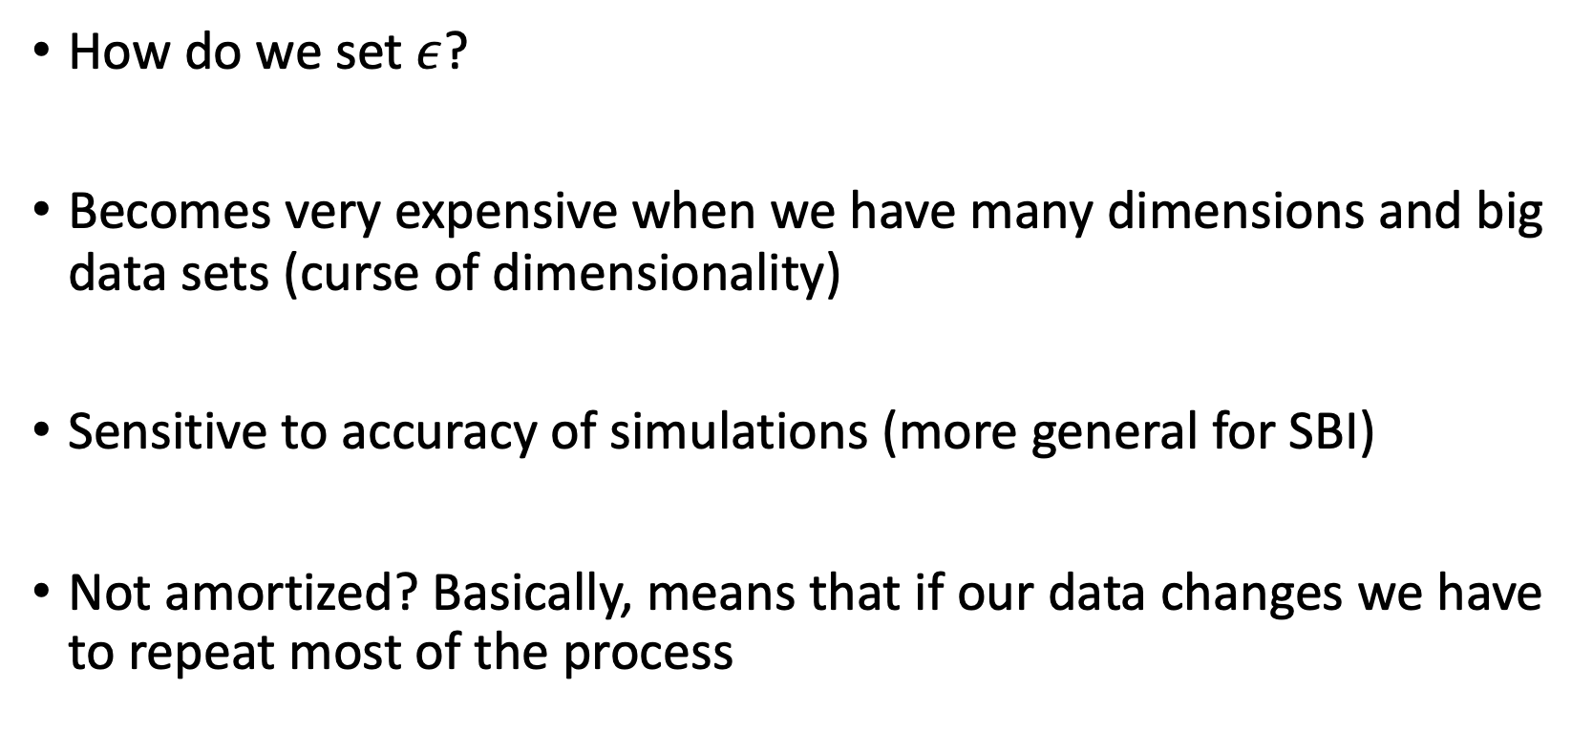
Problems with ABC?
How do we set $ε$?
Becomes very expensive when we have many dimensions and big data sets (curse of dimensionality)
Sensitive to accuracy of simulations (more general for SBI)
Not amortized? Basically, means that if our data changes we have to repeat most of the process

Slide 18
Neural Posterior Estimation (NPE)

Slide 19
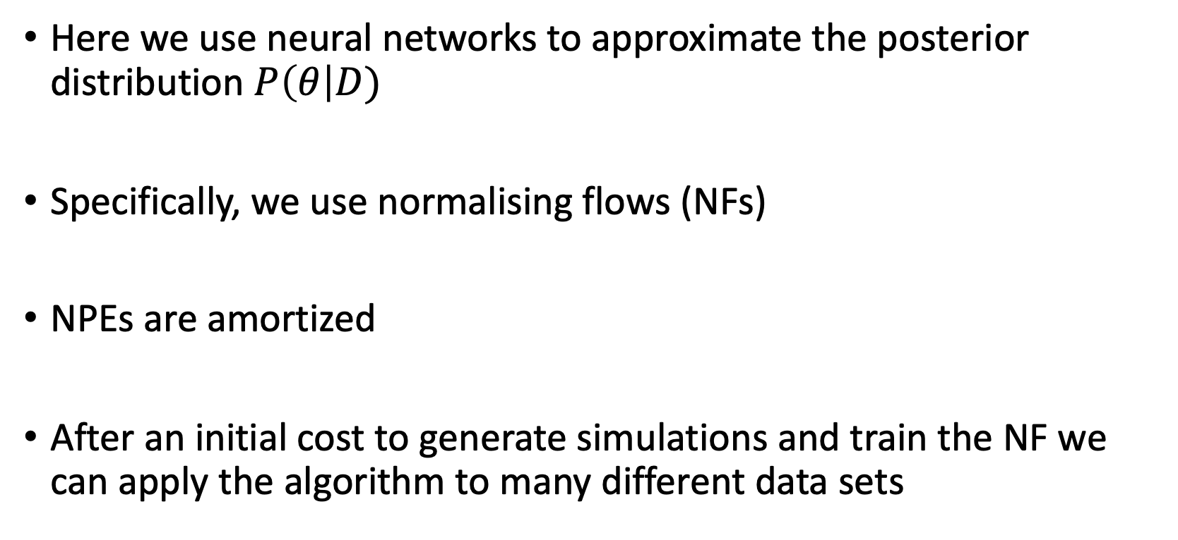
What is NPE?
Here we use neural networks to approximate the posterior distribution $P\left(θ\right|D)$
Specifically, we use normalising flows (NFs)
NPEs are amortized
After an initial cost to generate simulations and train the NF we can apply the algorithm to many different data sets

Slide 20
Normalizing Flows (NFs)
Invertible transformation from some known distribution (a multi-variate Gaussian) to a more complex target distribution (a posterior for example)
Many different types of NFs
Focusing on Masked Autoregressive Flows (MAF) which comprises of a series of Masked Autoencoder for Distribution Estimation (MADE, Papamakarios et al 2017) neural networks

Slide 21
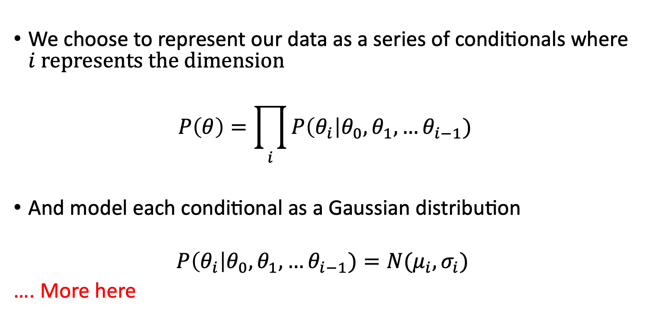
Normalizing Flows (NFs)
We choose to represent our data as a series of conditionals where $i$ represents the dimension
$$P\left(θ\right)=\prod_{i}{P\left(θ_{i}\right|θ_{0},θ_{1},…θ_{i−1})}$$
And model each conditional as a Gaussian distribution
$$P\left(θ_{i}\right|θ_{0},θ_{1},…θ_{i−1})=N(μ_{i},σ_{i})$$
…. More here

Slide 22
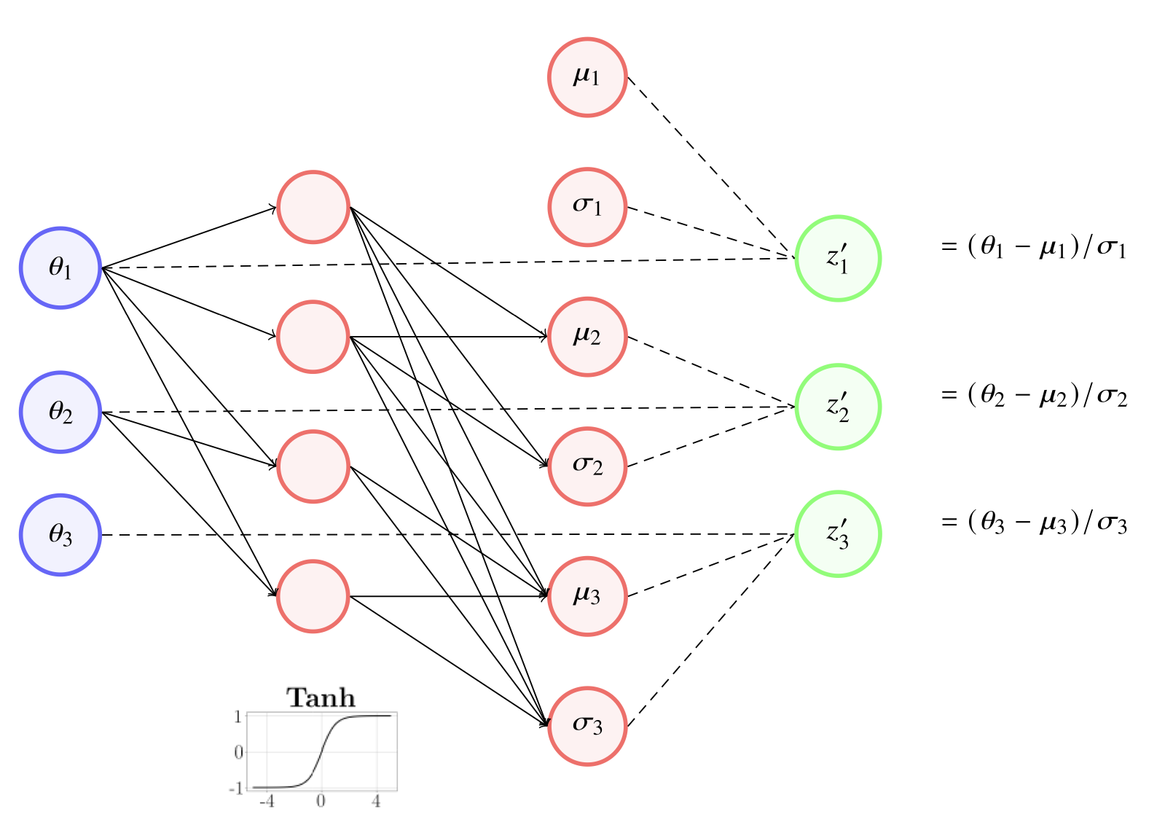
MADE
Bevins et al 2023

Slide 23
Neural Ratio Estimation (NRE)

Slide 24
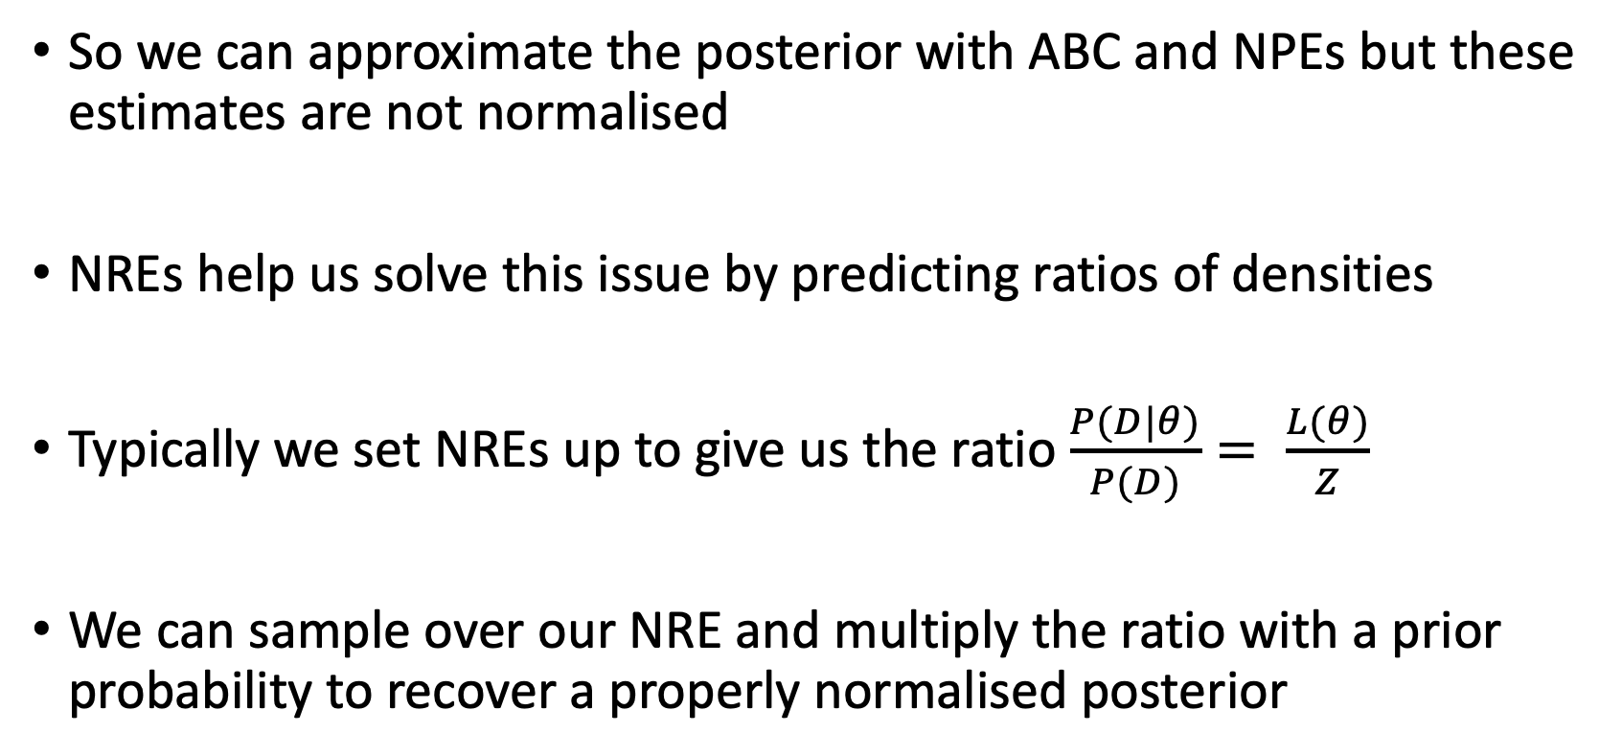
What is NRE?
So we can approximate the posterior with ABC and NPEs but these estimates are not normalised
NREs help us solve this issue by predicting ratios of densities
Typically we set NREs up to give us the ratio $\frac{P(D|θ)}{P(D)}= \frac{L(θ)}{Z}$
We can sample over our NRE and multiply the ratio with a prior probability to recover a properly normalised posterior

Slide 25
As a classification problem
NREs are essentially classifiers
During training we feed the neural network pairs of data and parameters that go together with a label (probability) of 1 and pairs that do not go together with label 0
Use a binary cross entropy loss function

Slide 26
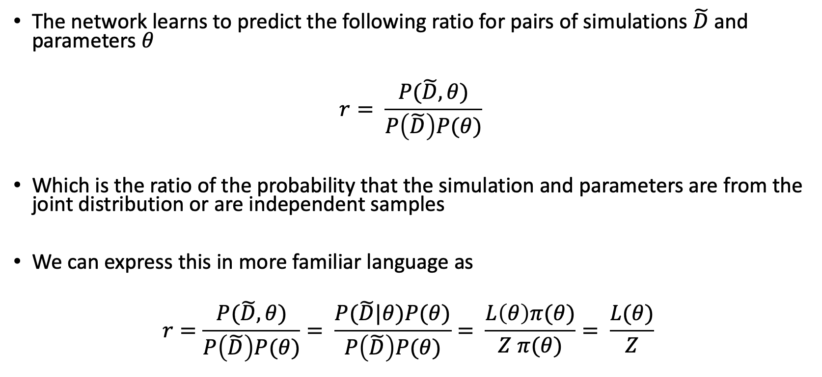
As a classification problem
The network learns to predict the following ratio for pairs of simulations $\tilde{D}$ and parameters $θ$
$$r= \frac{P(\tilde{D}, θ)}{P\left(\tilde{D}\right)P(θ)}$$
Which is the ratio of the probability that the simulation and parameters are from the joint distribution or are independent samples
We can express this in more familiar language as
$$r=\frac{P(\tilde{D}, θ)}{P\left(\tilde{D}\right)P(θ)}= \frac{P(\tilde{D}|θ)P(θ)}{P\left(\tilde{D}\right)P(θ)}= \frac{L\left(θ\right)π(θ)}{Z π(θ)}= \frac{L(θ)}{Z}$$

Slide 27
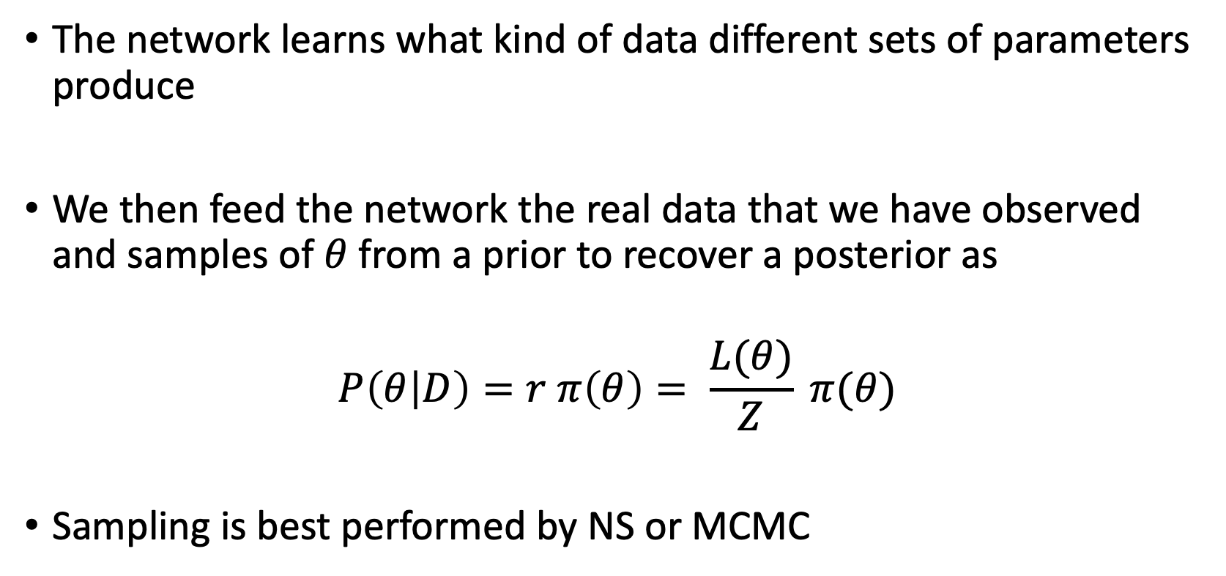
As a classification problem
The network learns what kind of data different sets of parameters produce
We then feed the network the real data that we have observed and samples of $θ$ from a prior to recover a posterior as
$$P\left(θ | D\right)=r π\left(θ\right)= \frac{L(θ)}{Z} π(θ)$$
Sampling is best performed by NS or MCMC

